Slide 1
UNIT 8 - AROUND THE GLOBE

Slide 2
CAN A TEENAGE ENVIRONMENTALIST CLEAN UP OUR OCEANS?
”We know that when we protect our oceans,
we are protecting our future.”
-Bill Clinton, a former US President

Slide 3

Listen to the introduction

Slide 4
Useful vocabulary (key words)
Current - morska (vodena) struja COMPOUND NOUNS:
Nutrients - hranjivi sastojci Food chain - lanac ishrane
Prey - plijen Ice cap - santa leda
Species - vrste Landfills - deponije
Tide - osjeka Oilfield - naftna polja

Slide 5
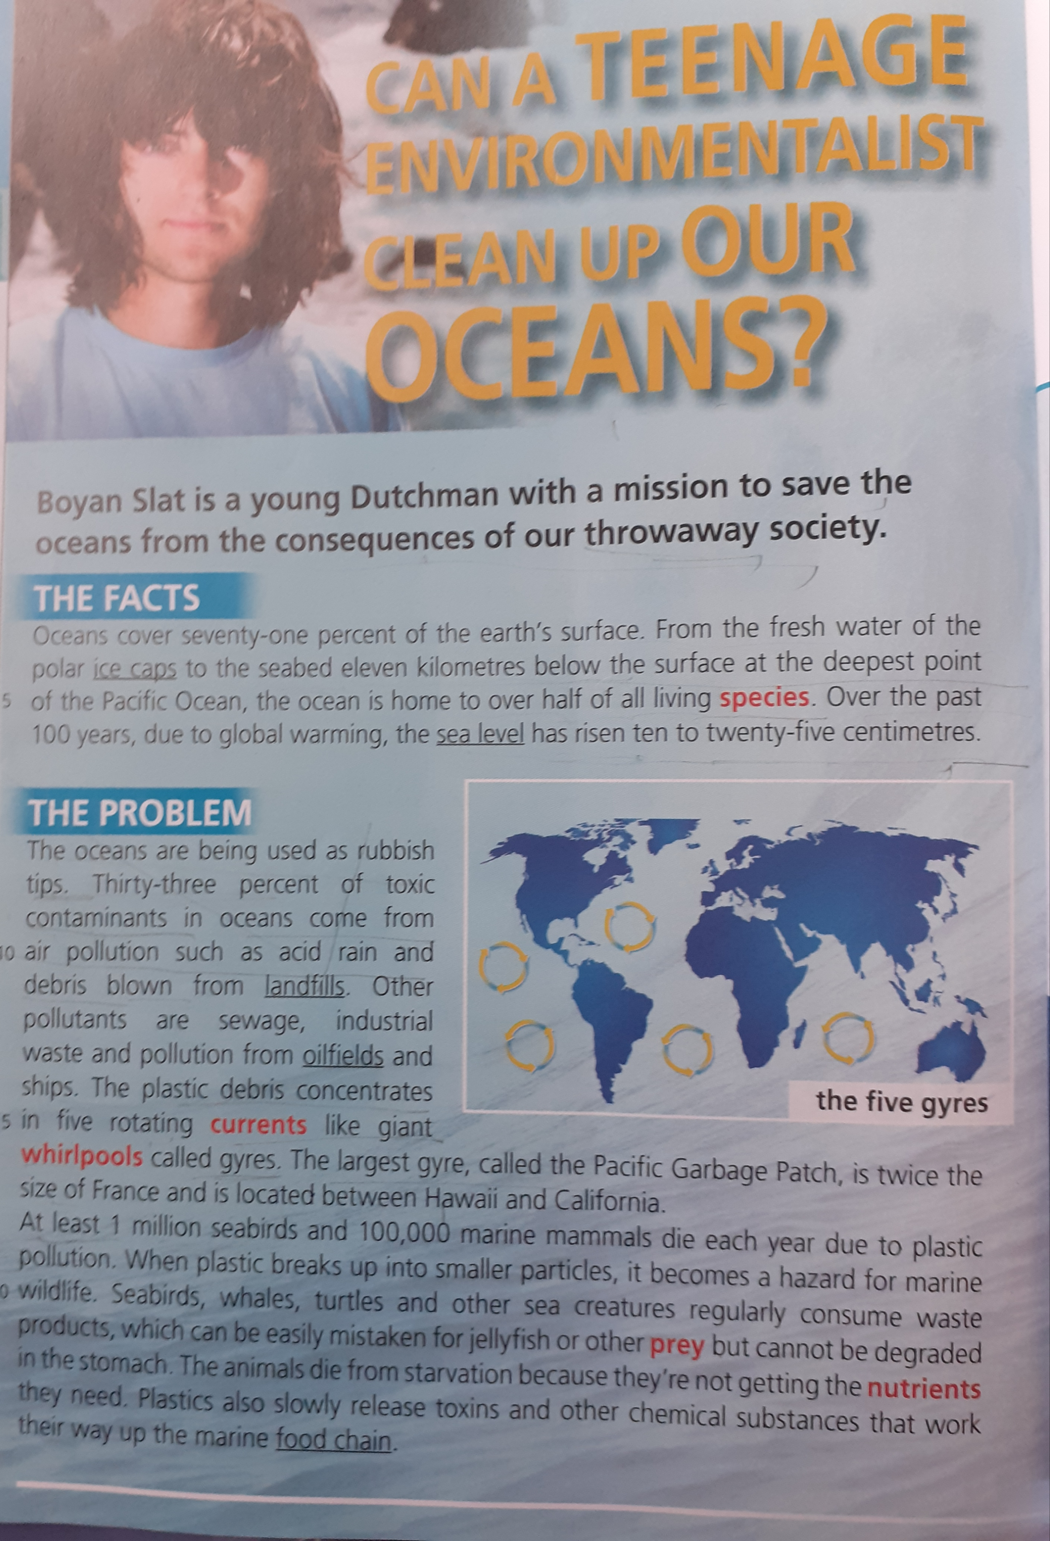
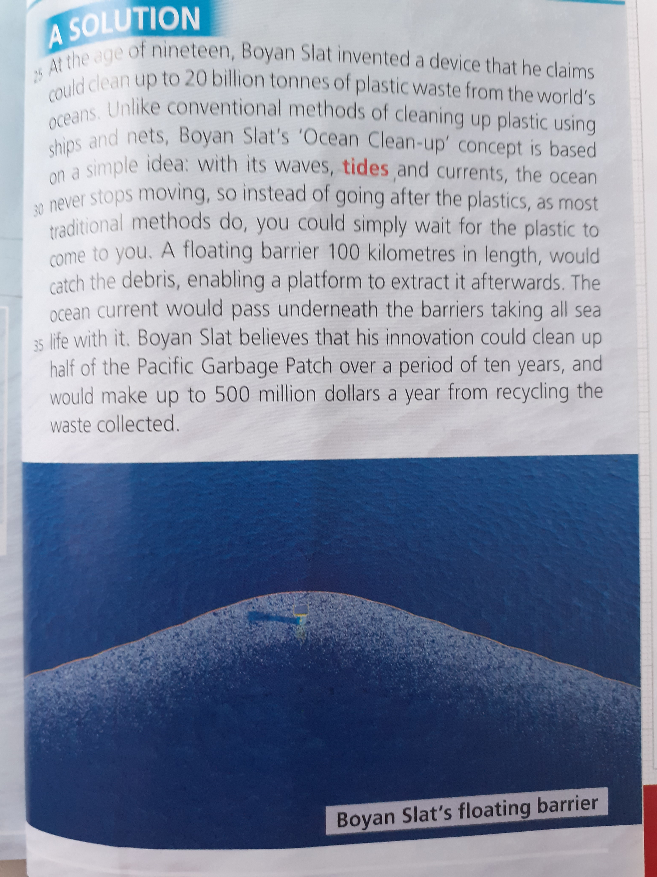
homework
Read a text Also, text from picture(students’ book, page 110), and try to remember the meaning of the words. You should do this lesson as your literature.
Thank you for your attention ☺

