Slide 1
Unit 8 - reading

Slide 2
The american civil rights movement
The civil rights movement was a movement in the USA in the 1950s and 1960s to end racial segregation and discrimination about black Americans and enforce voting rights for them. Martin Luther King Jr. ( 1929-1968) was a leader of the Civil Right Movements. He was assassinated in 1968.
Slavery was a system which treated people as property-they were bought, sold and forced to work.
Abraham Lincoln (1809-1865) was the sixteen President of the USA. Among other things, he abolished slavery,gave the govrment more power and modernise the economy. He was assassinated in 1865.
Segregation is the policy of keeping different groups of people , especially different races, appart.

Slide 3
USEFUl vocabulary (key words)
Slavery-ropstvo
declare-proglasiti
Racial segregation-rasno odvajanje
Seperate-rastaviti, odvojiti
Humiliate-poniziti
Assassinate-izvrsiti ubistvo

Slide 4
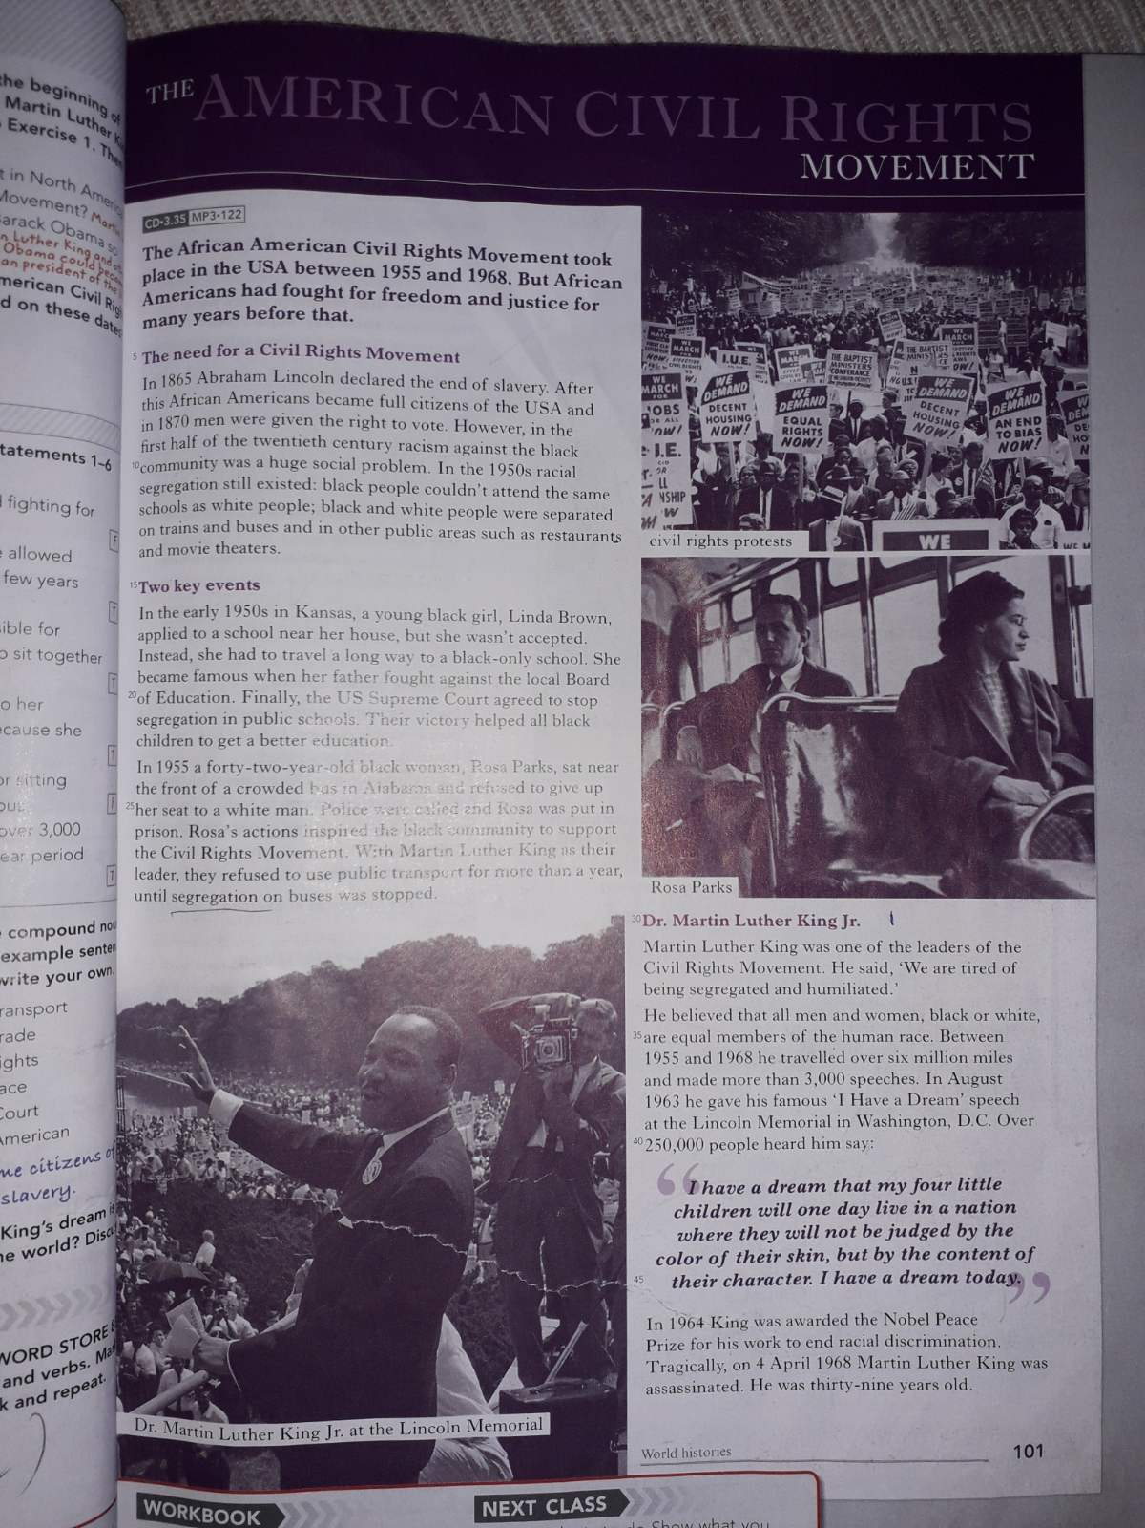
HOMEWORK
Read a text from the begining of presentation and try to remember the meaning of the words. Also, text from picture (students’ book, page 101) you should read as your literature.
Thank you for your attention ☺

