Slide 1
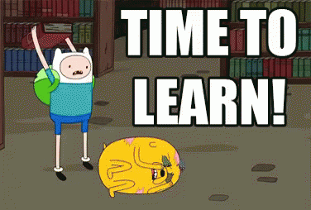
REPORTED SPEECH
4TH SENIOR B

Slide 2
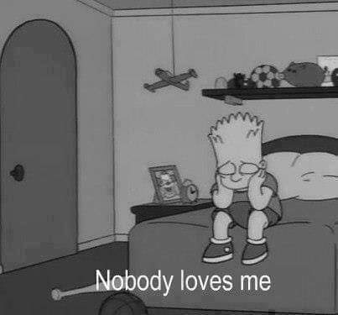
WE USE REPORTED SPEECH TO REPORT WHAT SOMEONE HAS SAID WITHOUT USING THEIR EXACT WORDS.
WHAT DID BART SAY??

Slide 3
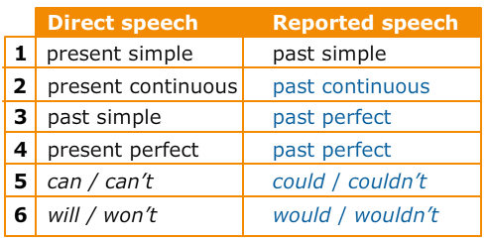
When we change DIRECT SPEECH to REPORTED SPEECH, we usually change the verb form to go ONE TENSE BACK

Slide 4
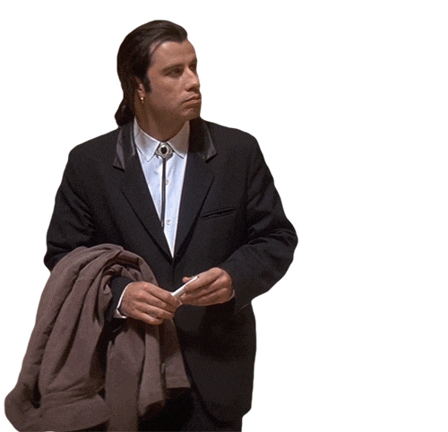
Changing pronouns, personal and possessive.
Pronouns change (or not) depending on the view of the reporter
I | ME | MY
HE/SHE | HIM/HER | HIS/HER
WE | US | OURS
THEY | THEM | THEIR
DIRECT SPEECH: JOHN SAID, “I AM COOKING”
REPORTED SPEECH: JOHN SAID THAT HE WAS COOKING

Slide 5
EXAMPLES/EXERCISES:
“I FEEL ILL”
SANDRA SAID
“I’M GOING INTO TOWN”
MARK SAID
“I studied music for five years”
Alex said
“I have lived in London since 2004.”
Tom said (THAT) HE HAD LIVED lived in London since 2004.
(THAT) SHE FELT ILL
(THAT) HE WAS GOING INTO TOWN
(THAT) HE HAD STUDIED MUSIC FOR FIVE YEARS

Slide 6
TIME AND PLACE CHANGES
It is often necessary to make time and place changes in relation to tense changes. TIME EXPRESSIONS:
DIRECT SPEECH | REPORTED SPEECH
NOW | THEN
TODAY | THAT DAY
TONIGHT | THAT NIGHT
YESTERDAY | THE DAY BEFORE
TOMORROW | THE FOLLOWING DAY/THE NEXT DAY
NEXT DAY/WEEK/MONTH/YEAR | THE FOLLOWING DAY/WEEK/MONTH/YEAR

Slide 7
EXAMPLES OF TIME CHANGING:
“I saw Tom yesterday”.
John said
“I’m going to Liza’s party tonight.”
María said
(that) he had seen Tom the day before.
(that) she was going to Liza’s party that night.

Slide 8
SAY & TELL
TELL SOMEBODY (SOMETHING)
She told me her name.
NOT She said me her name.
SAY SOMETHING (TO SOMEBODY)
We said goodbye to our cousins.

Slide 9
HOMEWORK
You should read the text about Mistery German forest boy.
Do the following exercise:
Report what the witnesses told the police.
1 We saw the burglars in the office,' said Mrs Reid.
  Mrs Reid told_______________.
2 I have never been witness to a crime before,' said Mr Ross.
  Mr Ross said _______________.
3 ’I feel very frightened,' said Miss Hill.
  Miss Hill said _______________.
4 I'm still shaking,' added Miss Hill.
  Miss Hill added _______________.
5 'I can't stop thinking about the burglary,' said Mrs Reid.
  Mrs Reid said _______________.
'I haven't been to the office since the burglary,' added Mrs Reid.
  Mrs Reid added _______________.

